Slide 1
McDonald’s Review Predictions
MS-AAI-501 Team 1 Final Project
Paul Parks, Lishi Wang, Ivan Steklov

Slide 2
Introduction

Slide 3

Introduction
Customer feedback and online reviews significantly influence consumer behavior.
Understanding and analyzing this feedback is essential for businesses aiming to thrive in competitive markets.
Can we determine customer sentiment purely based on text reviews?
Notes:
Alden

Slide 4
Objective
Conduct sentiment analysis on McDonald's customer reviews
Explore geographic trends in reviews and ratings
Predict star ratings based on review text.
Notes:
Alden

Slide 5
Target Audience
Our target audience is business leaders in the Food industry who wish to improve the reviews of their storefronts or create an easier way for customers to create reviews.
The ability to calculate sentiment based on text reviews can have positive benefits including:
Customer Insights
Product and Service Improvement
Customer Segmentation
Notes:
Alden

Slide 6
Dataset

Slide 7
Dataset
Dataset collection of over 33,000 anonymized Google reviews for various McDonald's locations within the United States
10 Features
Kaggle dataset from public Google reviews
https://www.kaggle.com/datasets/nelgiriyewithana/mcdonalds-store-reviews
Notes:
Alden

Slide 8
Dataset
reviewer_id: A unique identifier for each reviewer, ensuring anonymity.
store_name: The name of the specific McDonald's store under review.
category: The category or type of store, providing context to the location.
store_address: The physical address of the store.
latitude: The latitude coordinate of the store's geographical location.
longitude: The longitude coordinate of the store's geographical location.
Notes:
Alden

Slide 9
Dataset
rating_count: The total number of ratings or reviews for the particular store.
review_time: The timestamp when the review was posted.
review: The textual content of the customer's review.
rating: The rating provided by the reviewer on a predetermined scale.
Notes:
Alden

Slide 10
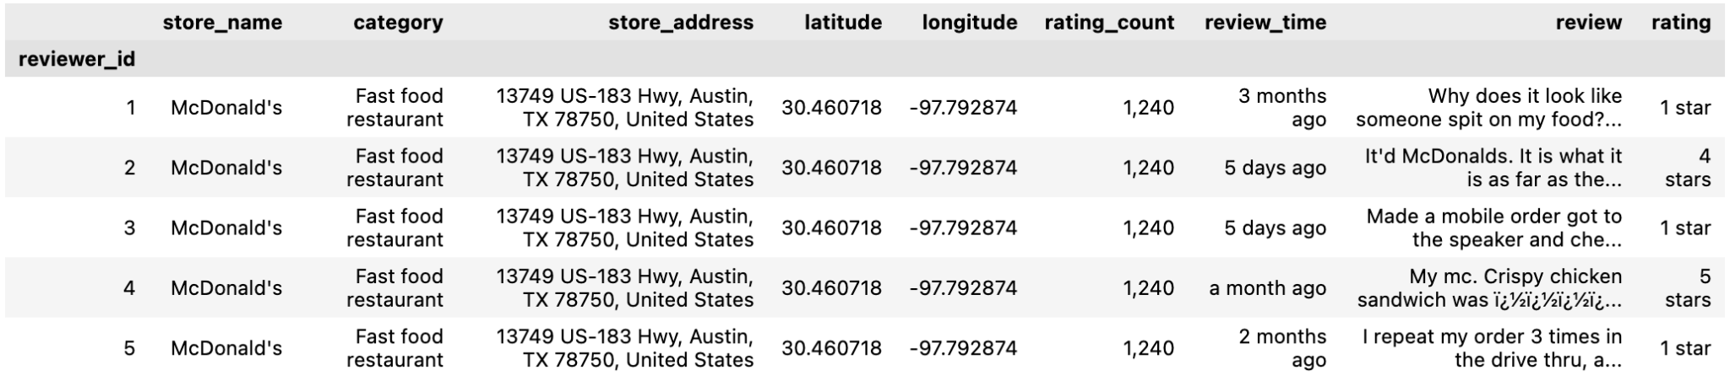
Dataset
Notes:
Alden

Slide 11
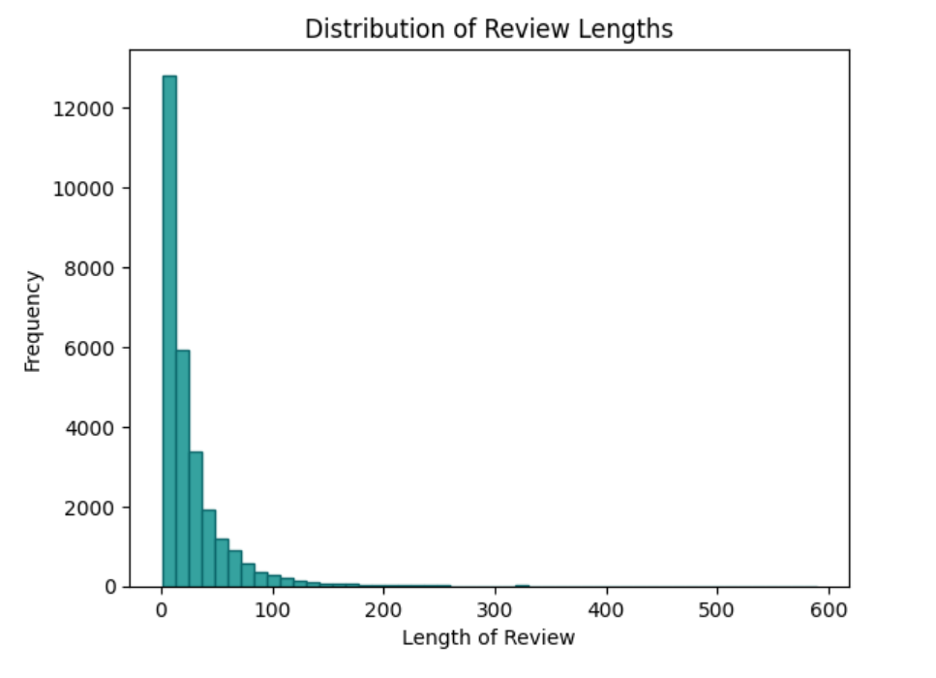
Dataset - Review
The review lengths range from a minimum of 1 word to a maximum of 589 words. The majority of reviews are only a few words long.
Notes:
Alden

Slide 12
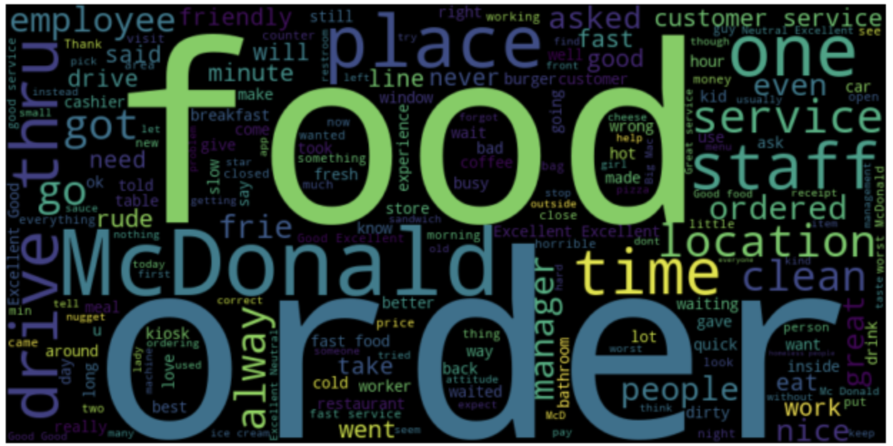
Dataset - Review
The most commonly used words are “I”, “food”, “order”, “service”, “The”, “McDonald”, “get”, “place”, “good”, and “time”.
Notes:
Alden

Slide 13
Location Analysis

Slide 14
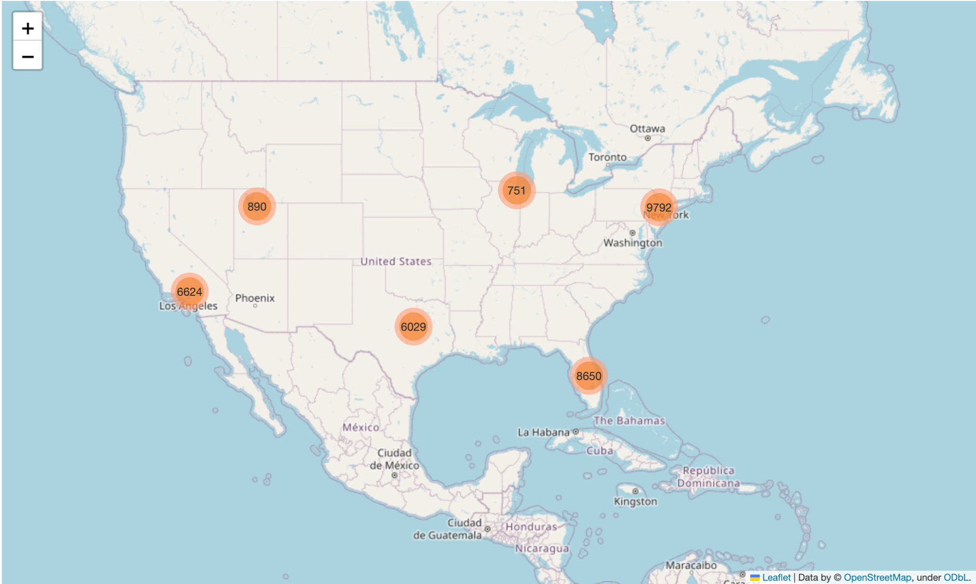
Dataset - Locations
The dataset contains 33,000 anonymized Google reviews from 11 States.
Notes:
Alden

Slide 15
Location - State
A geolocation analysis was conducted to understand the geographical patterns of customer satisfaction within the dataset, focusing on the average star ratings across different states in the United States.
Notes:
Alden

Slide 16
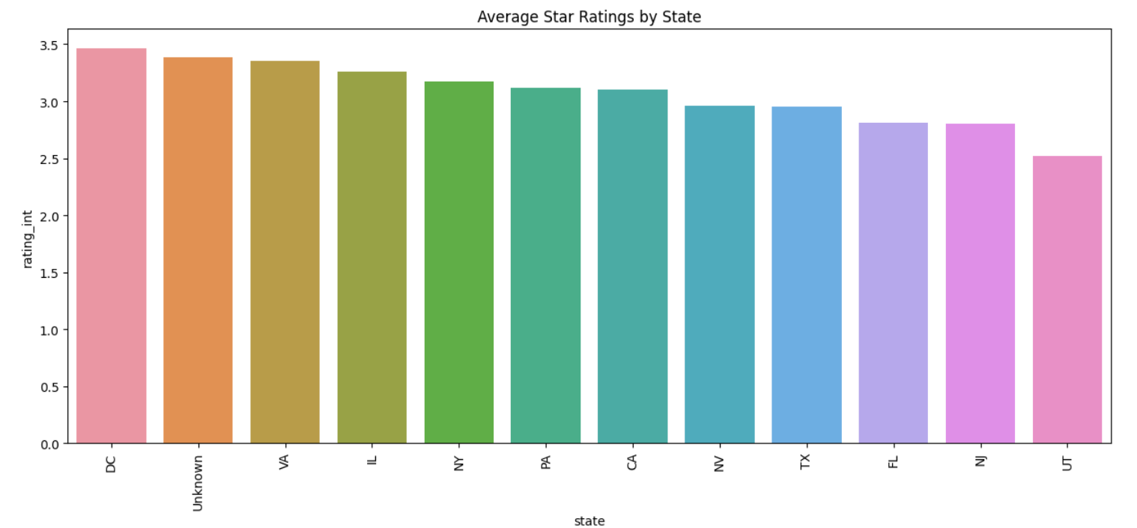
Location - State
Notes:
Alden

Slide 17
Cleaning

Slide 18
Dataset Cleaning and Preprocessing
Renamed the 'latitude ' column, which had an extraneous space, to 'latitude' to ensure consistency within the dataset.
Several unwanted characters (e.g., '½ï', 'ï', '½', '¿') were identified in the 'review' and 'store_address' columns. These are errors in encoding and rendering, and are removed.
A new column ‘review_string_list’ was added, slicing the review into a list of it’s individual words, removing punctuation.
Notes:
Alden

Slide 19
Dataset Cleaning and Preprocessing
Many reviews did not have written content. In those cases, the star rating was converted to a default sentiment. The scale is 1=Bad/Terrible, 2=Poor, 3=Neutral, 4=Good, 5=Excellent. These default reviews were removed we want to train the model based on actual text content.
A new column, 'rating_int,' was created, converting the rating data from string to integer format.
A new 'state' column was created, extracting the two-letter state abbreviation from the 'store_address' column
Notes:
Alden

Slide 20
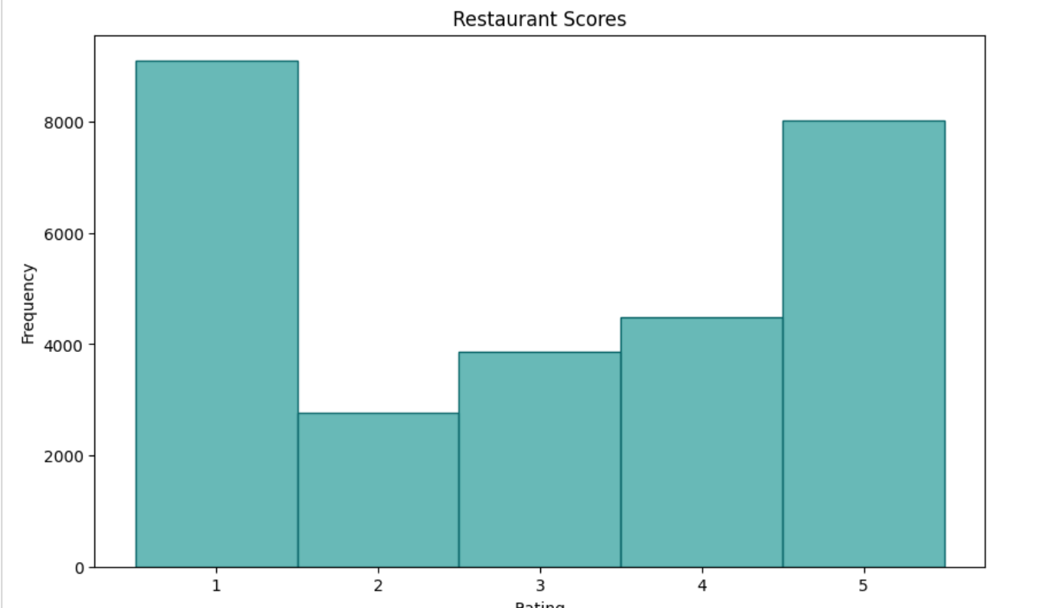
Dataset Cleaning and Preprocessing
After the initial cleaning and preprocessing, we see imbalance in the data. The majority of reviews are either 1 or 5 stars. We will combine 2, 3, 4 into one category. The sentiment scale we will use is: 1 = Terrible 2 = Neutral 3 = Excellent

Slide 21
Sentiment Analysis

Slide 22
Training - Split
The dataset was divided into training and testing subsets, with 80% allocated for training and 20% for testing. The training set contained 22582 samples, and the testing set included 5646 samples.
Notes:
Alden

Slide 23
Training - Embedding
The Google Universal Sentence Encoder was used to embed the reviews which would allow the regression model to predict review scores.
Embedding is the process of converting a sentence into a numerical vector by capturing the semantic meaning of the words and the structure of the sentence, allowing it to be mathematically manipulated and analyzed.
Notes:
Alden

Slide 24
Training - Ridge Regression
The SciKit Ridge Regression model was used for the Regression model. We will use this model to try to predict the review score based on text.
The coefficient of determination (R² score) for the Ridge Regression model trained on embeddings was 0.6339
Notes:
Alden

Slide 25
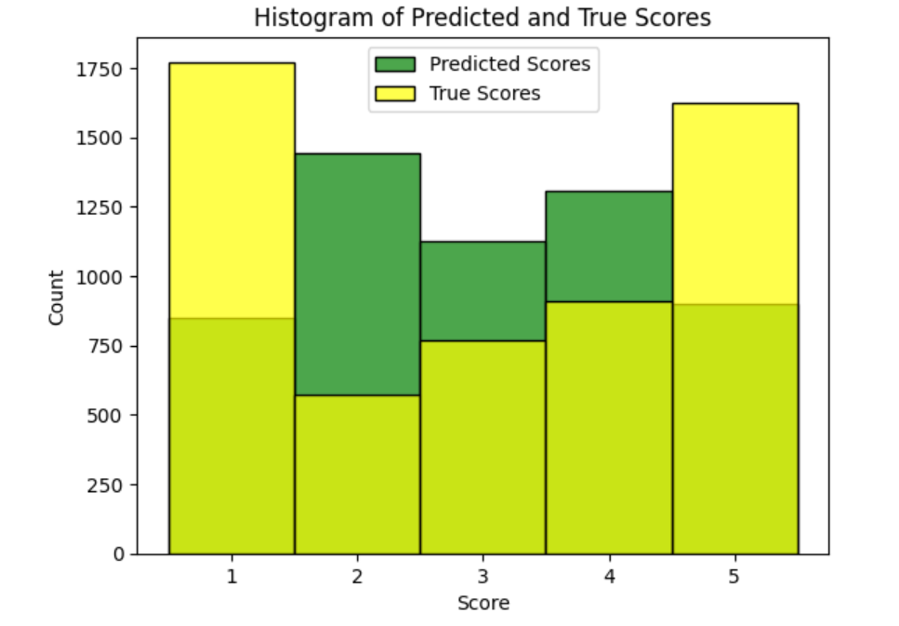
Training - Ridge Regression
Predicted scores vs True scores in a histogram.
The histogram shows some overestimation in the neutral (2-4) range, and some underestimation of bad (1) and excellent (3).
Notes:
Alden

Slide 26
Training - Bayesian
The SciKit Bayesian Ridge Regression model was used for the Bayesian model, to compare to simple Ridge Regression. This produced a model that achieved a r^2 score of 0.641, so it was not a notable improvement over simple Ridge Regression.
Notes:
Alden

Slide 27
Training - SVM
Ridge Regression calculates a continuous score, as a result of calculating regression distance, so it does not do explicit classification. In addition, the imbalance in the data may have cause a loss in accuracy with trying to predict the exact review score. We trained a SVM model to see how it performs in sentiment classification, and combining the scarcer categories together. The result was that it performed better than Ridge, with an accuracy score of 71.7%. SVM did perform worse in terms of speed, which should be noted.

Slide 28
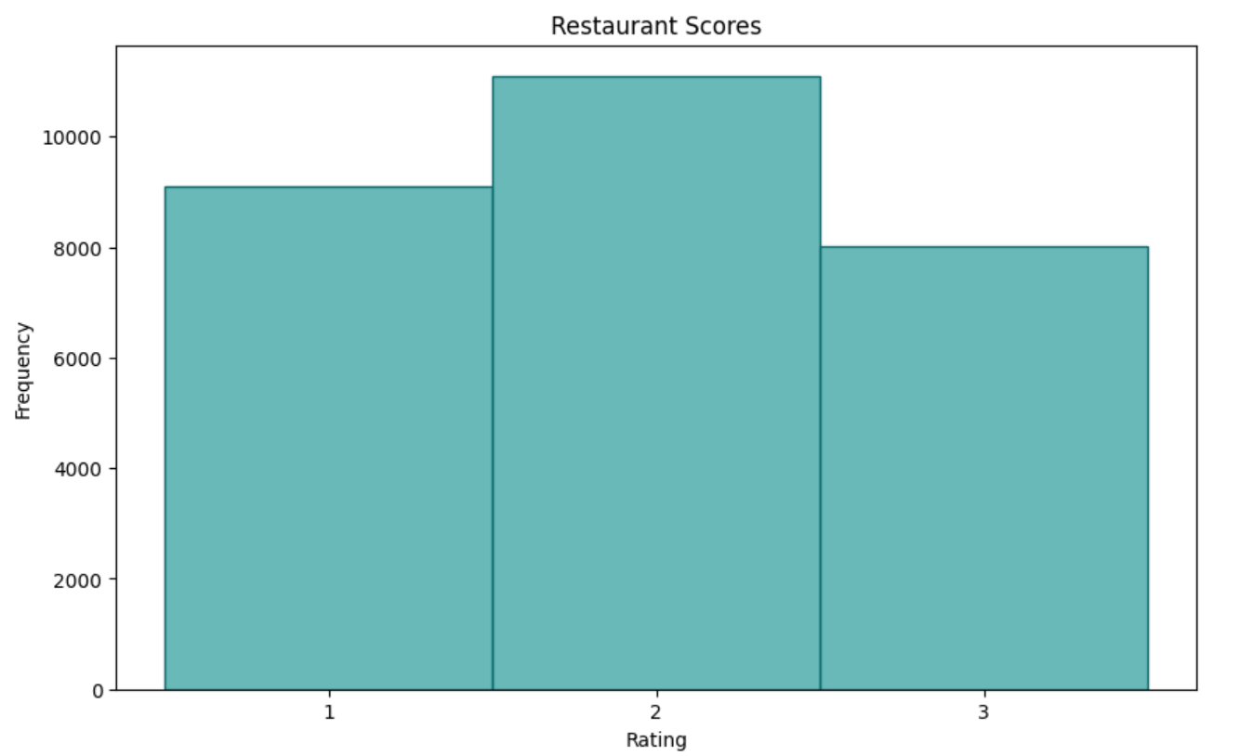
Dataset Cleaning and Preprocessing
Data visualization after correcting imbalance.

Slide 29
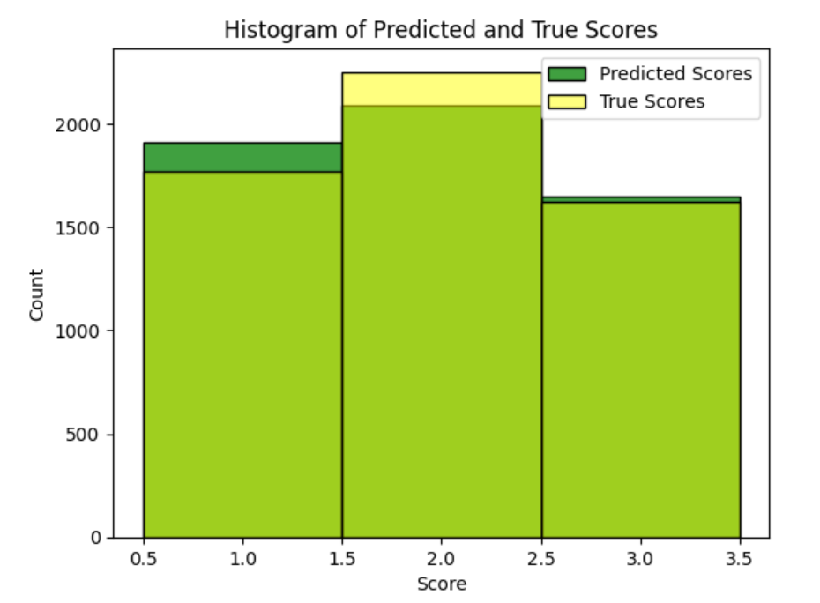
Training - SVM

Slide 30
Conclusion

Slide 31
Conclusions
The implementation of the Ridge regression model aimed at predicting review scores using the Google Universal Sentence Encoder embeddings. This approach resulted in a coefficient of determination (R² score) of 0.6334.
The Bayesian Ridge model was also implemented, resulting in an R² score of 0.6341. The proximity of these scores suggests a similar level of performance between the Ridge and Bayesian Ridge models in predicting review ratings.
However, it was the SVM model that performed best, as it is a classifier instead of calculating a score that is subject to some subjective analysis (what is the difference between 1 and 1.3, for example. Correcting the data imbalance and performing a sentiment analysis versus a score prediction.
Notes:
Alden

Slide 32
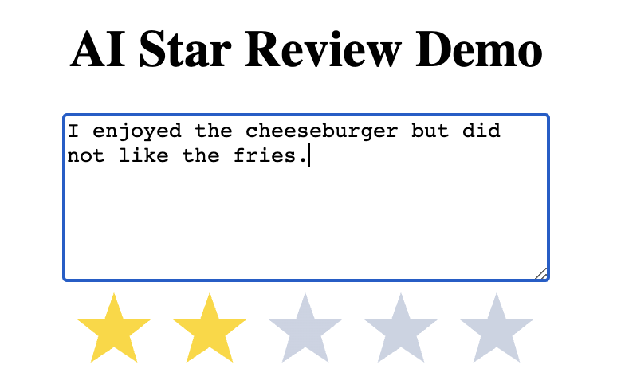
Outcome - Demo
The model produced in this project can be used to improve business by calculating sentiment from customer reviews without requiring customers to input a star rating.
Notes:
Alden

